Slide 1
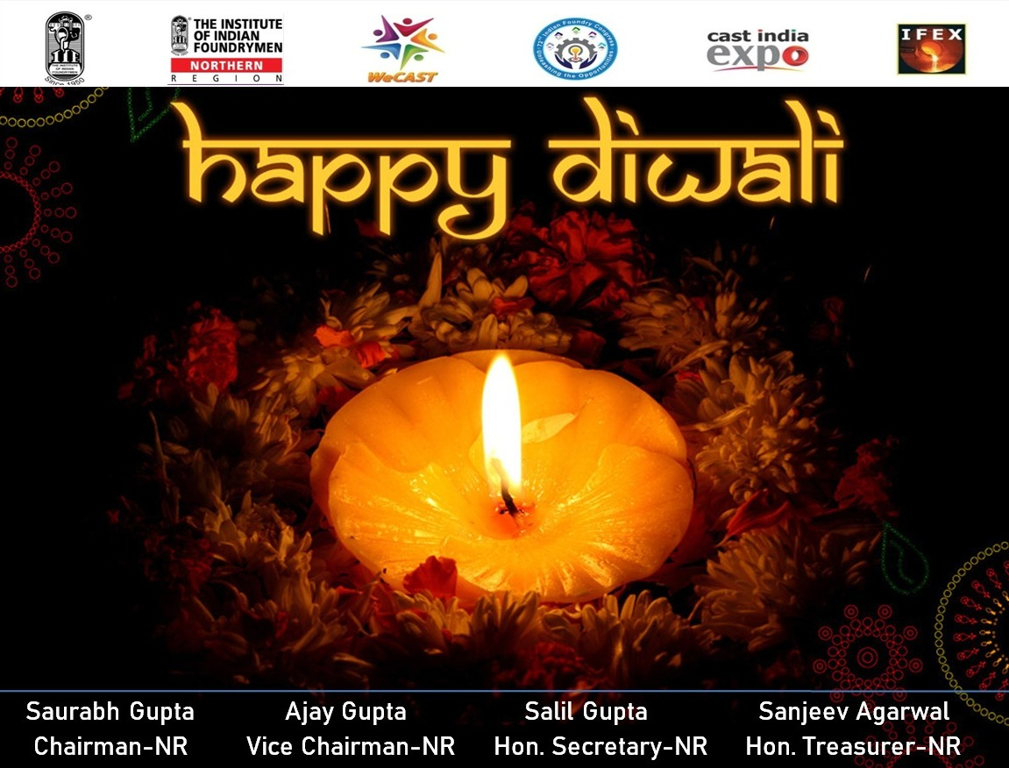

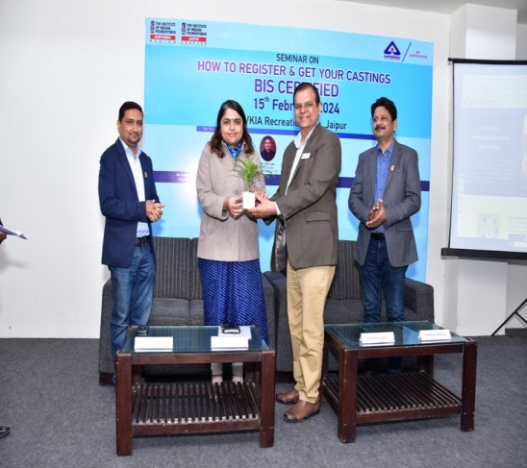
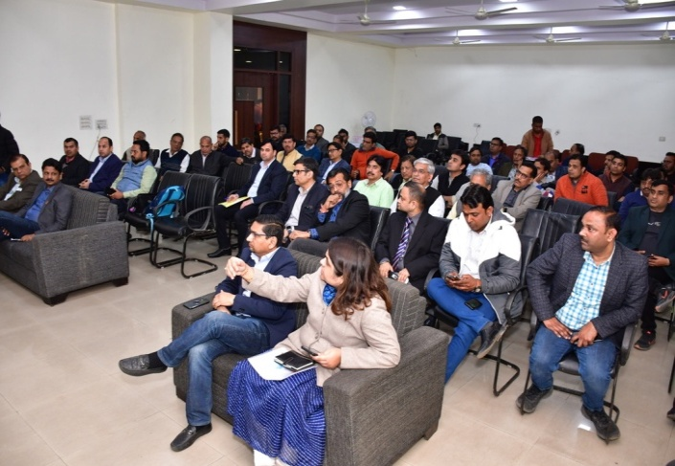
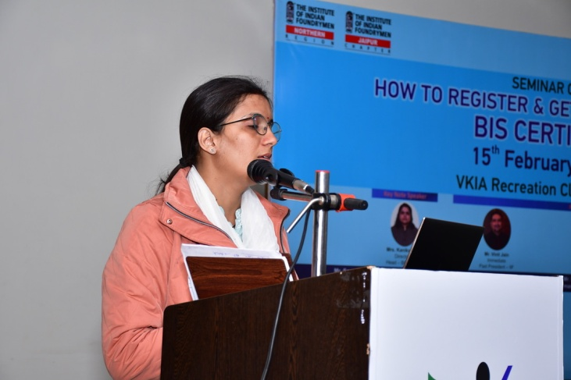
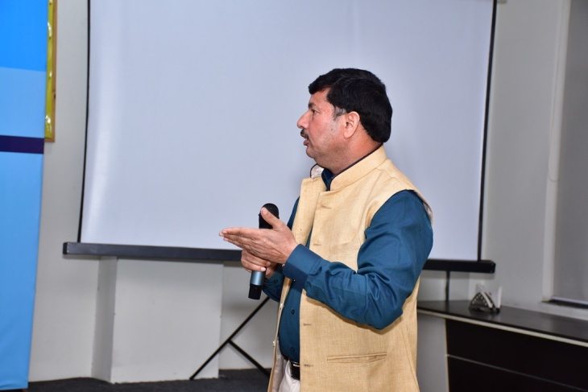
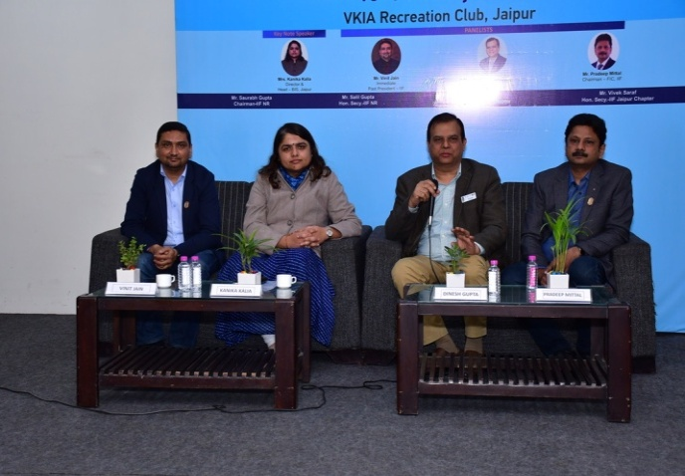
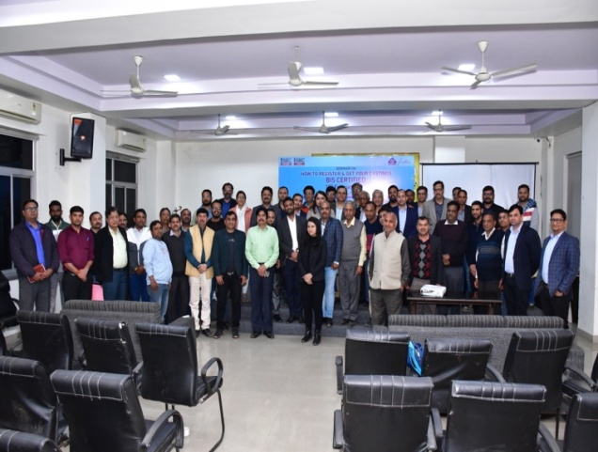
1. Awareness Seminar at Jaipur
IIF Northern Region and IIF Jaipur Chapter jointly with BIS organized a seminar on “How to register and get your castings BIS certified ” on 15th February 2024 at VKIA Recreation Club, Jaipur. Director & Head, BIS Jaipur Ms. Kanika Kalia was the Key Speaker.

